Slide 1


Spring 2021
SKKU Biostats and Big data
CHOONG-WAN WOO | COCOAN lab | http://cocoanlab.github.io

Slide 2
GBME Probability and Statistics
Lecture 17
Lecture 17
Inferences about means
CHOONG-WAN WOO | COCOAN lab | http://cocoanlab.github.io

Slide 3
Lecture 17
Review: Key Points
Chapter 20: Testing Hypotheses About Proportions
Hypothesis testing: the logic of jury trial
P-value: the probability of seeing the observed data given that the null hypothesis is true.
P-value is for decision-making, but it should not be blinded. It’s context-dependent.
Many issues related to P-values: “Small P value can make a hypothesis more plausible, but the difference may not be dramatic.”
Problems in misuses of P-value are just the tip of the iceberg.
Let’s not fool ourselves!
CHOONG-WAN WOO | COCOAN lab | http://cocoanlab.github.io

Slide 4
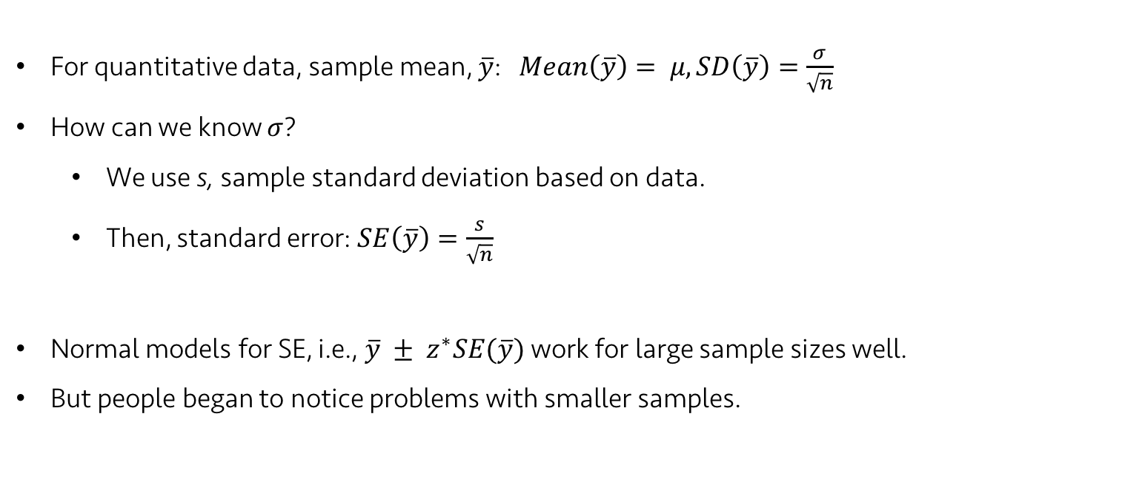
Lecture 17
Central Limit Theorem for Means
For quantitative data, sample mean, $\overline{y}$: $Mean\left(\overline{y}\right)= μ, SD\left(\overline{y}\right)=\frac{σ}{\sqrt{n}}$
How can we know $σ$?
We use s, sample standard deviation based on data.
Then, standard error: $SE\left(\overline{y}\right)=\frac{s}{\sqrt{n}}$
Normal models for SE, i.e., $\overline{y} ± z^{∗}SE(\overline{y})$ work for large sample sizes well.
But people began to notice problems with smaller samples.
CHOONG-WAN WOO | COCOAN lab | http://cocoanlab.github.io

Slide 5
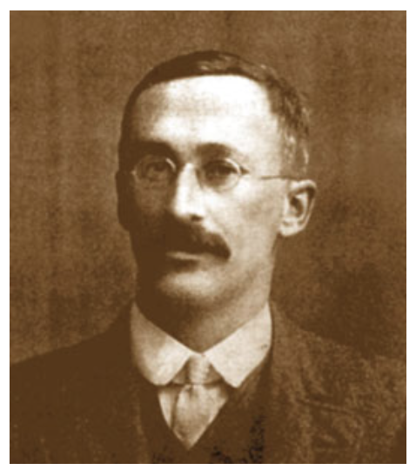
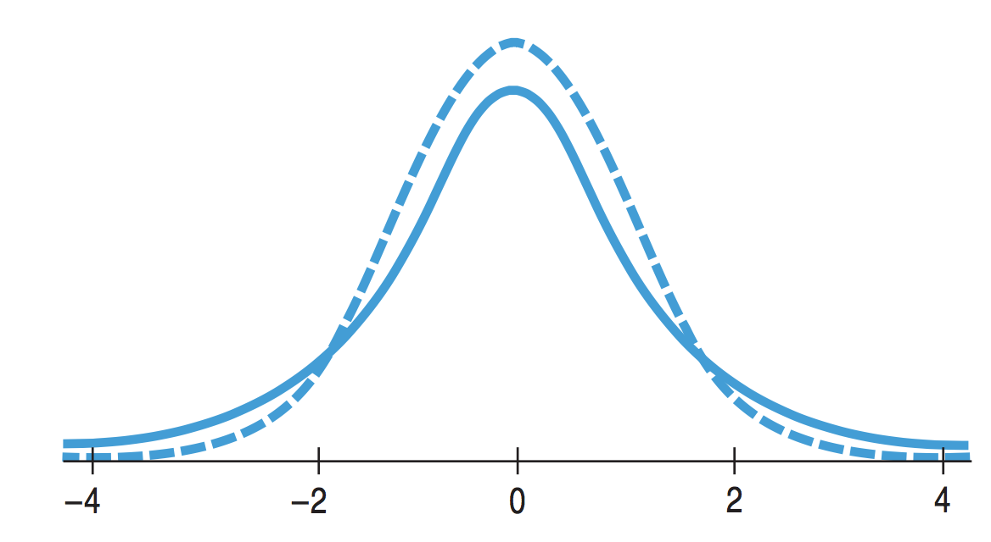
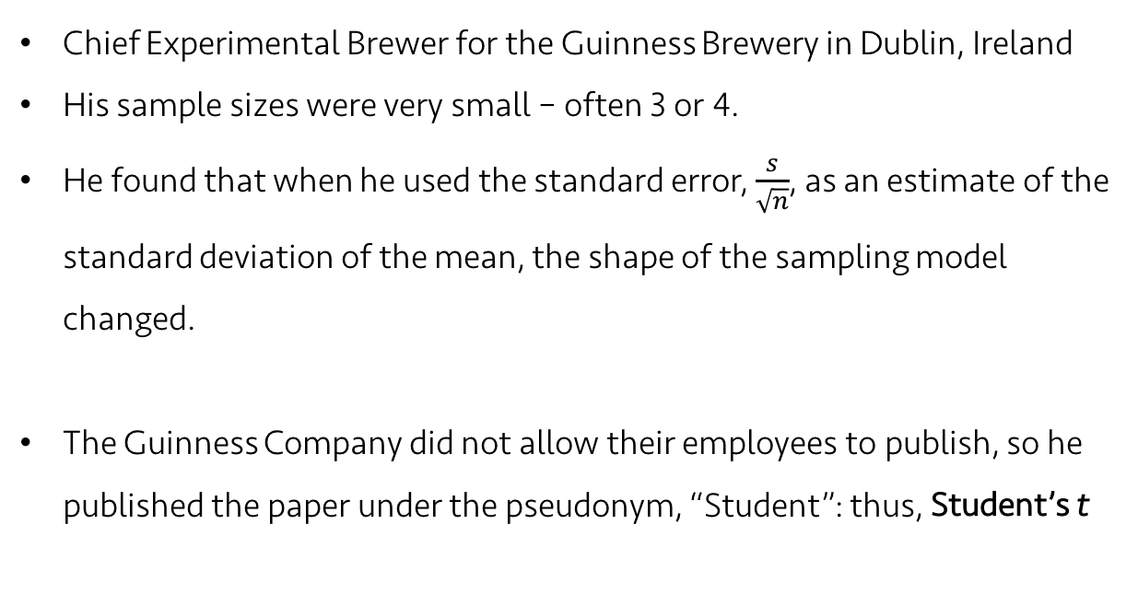
Lecture 17
Gosset’s t
William S. Gosset (1876-1937)
Chief Experimental Brewer for the Guinness Brewery in Dublin, Ireland
His sample sizes were very small – often 3 or 4.
He found that when he used the standard error, $\frac{s}{\sqrt{n}}$, as an estimate of the standard deviation of the mean, the shape of the sampling model changed.
The Guinness Company did not allow their employees to publish, so he published the paper under the pseudonym, “Student”: thus, Student’s t
dashed: z
solid: t
CHOONG-WAN WOO | COCOAN lab | http://cocoanlab.github.io

Slide 6
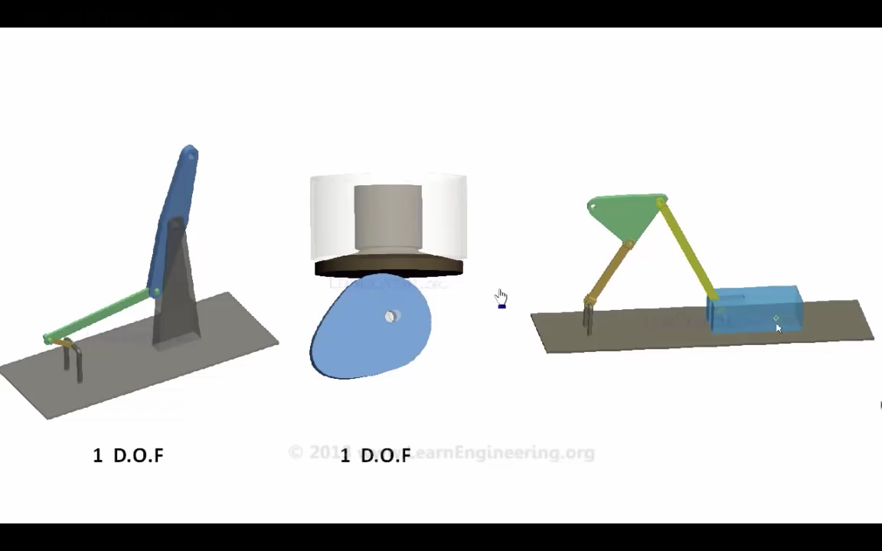
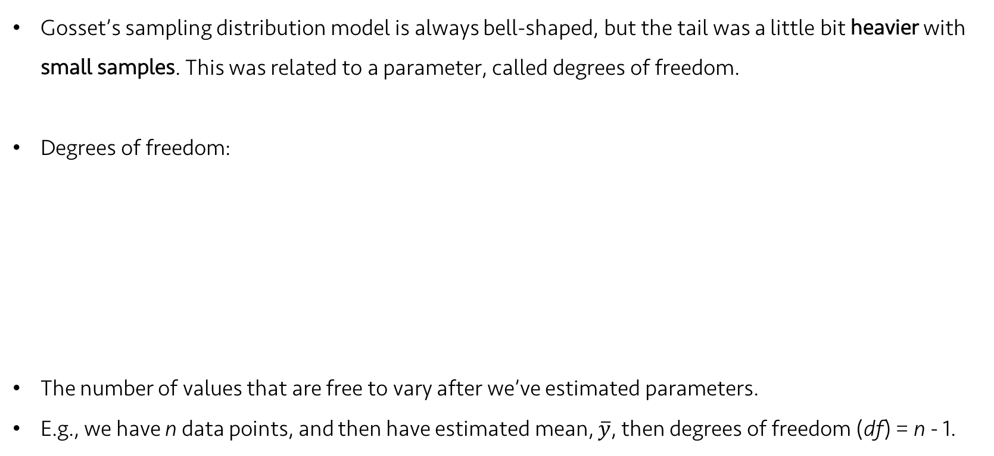
Lecture 17
Degrees of freedom
Gosset’s sampling distribution model is always bell-shaped, but the tail was a little bit heavier with small samples. This was related to a parameter, called degrees of freedom.
Degrees of freedom:
The number of values that are free to vary after we’ve estimated parameters.
E.g., we have n data points, and then have estimated mean, $\overline{y}$, then degrees of freedom (df) = n - 1.
CHOONG-WAN WOO | COCOAN lab | http://cocoanlab.github.io

Slide 7
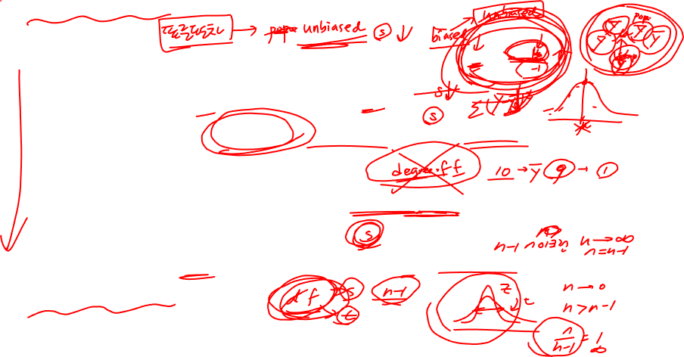
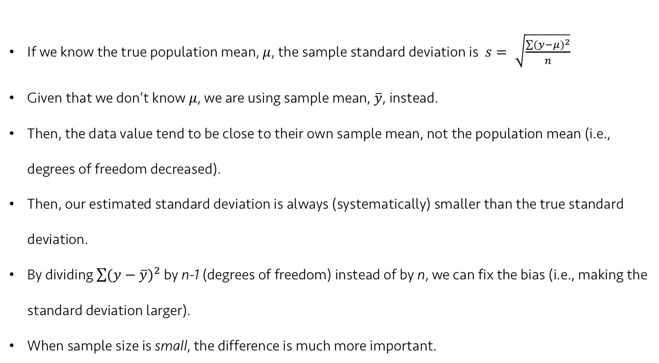
Lecture 17
Why standard deviation is divided by n – 1 (finally)
If we know the true population mean, $μ$, the sample standard deviation is $s= \sqrt{\frac{\sum{{(y−μ)}^{2}}}{n}}$
Given that we don’t know $μ$, we are using sample mean, $\overline{y}$, instead.
Then, the data value tend to be close to their own sample mean, not the population mean (i.e., degrees of freedom decreased).
Then, our estimated standard deviation is always (systematically) smaller than the true standard deviation.
By dividing $\sum{{(y−\overline{y})}^{2}}$ by n-1 (degrees of freedom) instead of by n, we can fix the bias (i.e., making the standard deviation larger).
When sample size is small, the difference is much more important.
CHOONG-WAN WOO | COCOAN lab | http://cocoanlab.github.io

Slide 8
Lecture 17
Quiz 17-01
https://forms.gle/W357DqpEfRB58nro7
CHOONG-WAN WOO | COCOAN lab | http://cocoanlab.github.io

Slide 9
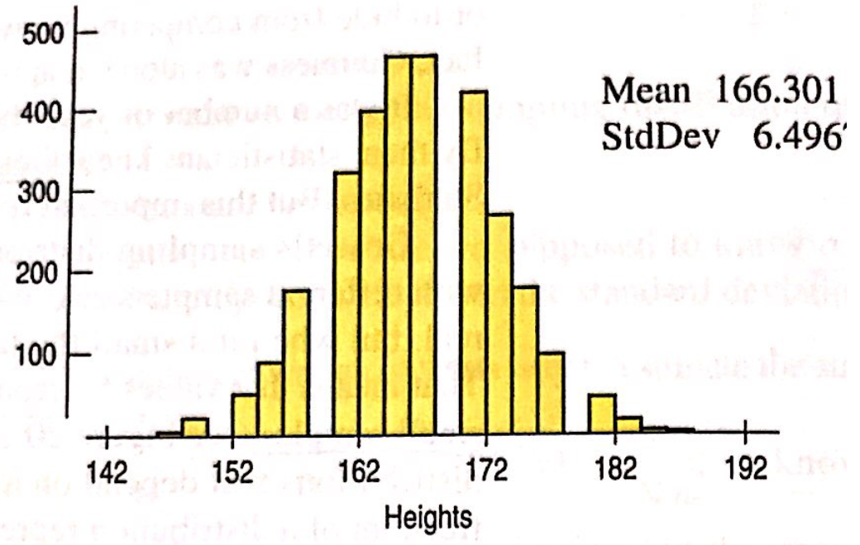
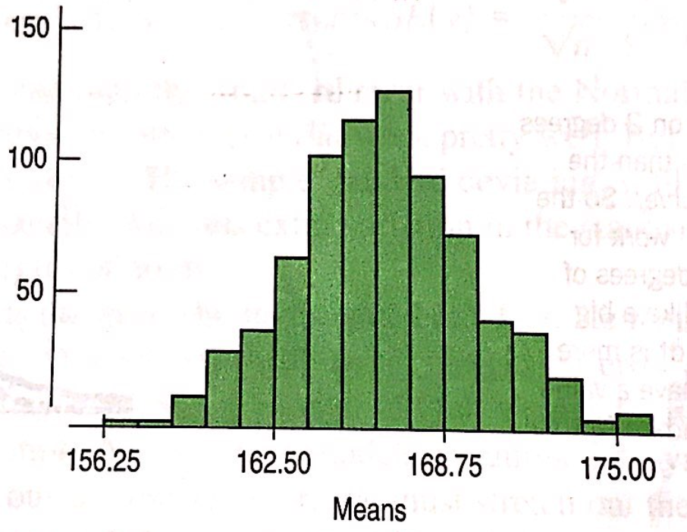
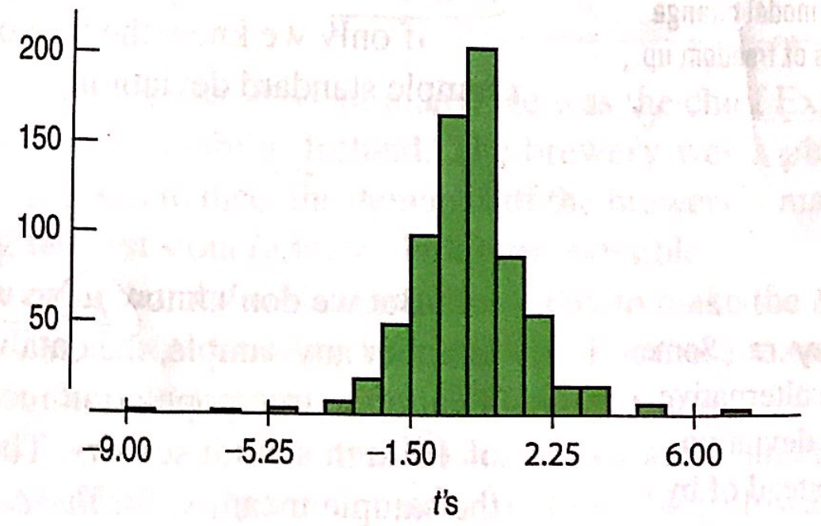
Lecture 17
What Gosset see:
Gosset’s simulation (sample n = 4)
Computer simulation
When normal model is used
dashed: z
solid: t
CHOONG-WAN WOO | COCOAN lab | http://cocoanlab.github.io

Slide 10
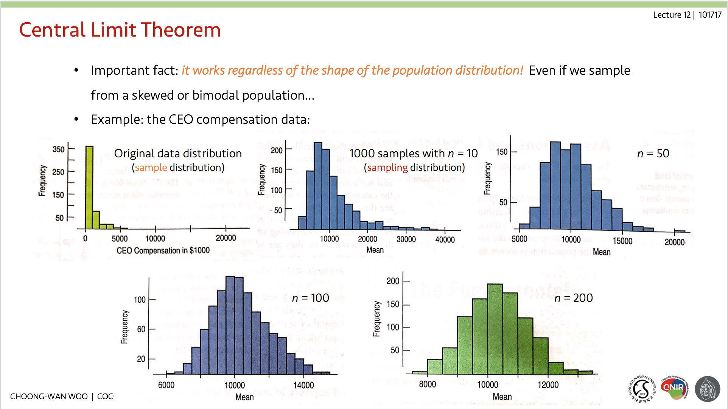
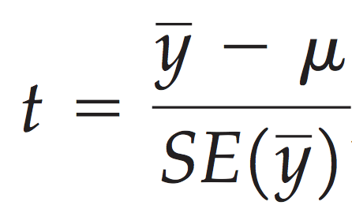
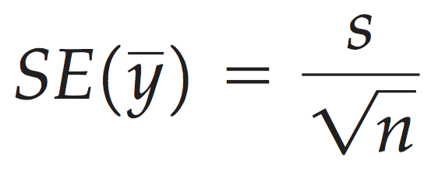
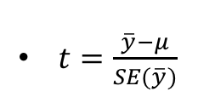
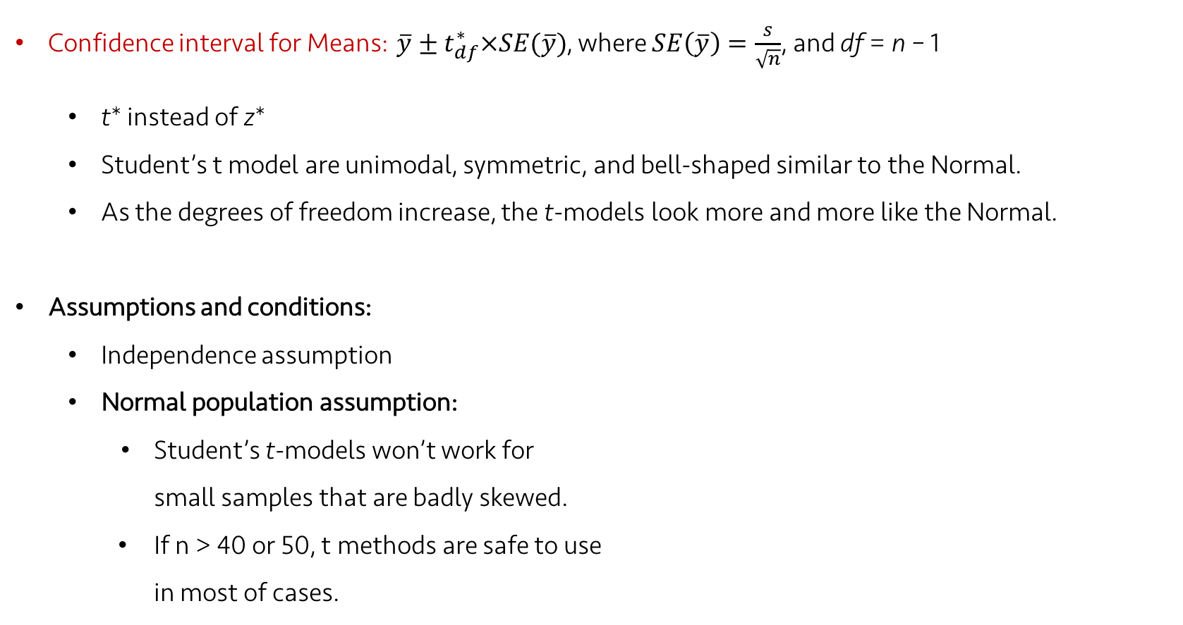
Lecture 17
A Confidence Interval for Means
Confidence interval for Means: $\overline{y}±t_{df}^{∗}×SE(\overline{y})$, where $SE\left(\overline{y}\right)=\frac{s}{\sqrt{n}}$, and df = n – 1
t* instead of z*
Student’s t model are unimodal, symmetric, and bell-shaped similar to the Normal.
As the degrees of freedom increase, the t-models look more and more like the Normal.
Assumptions and conditions:
Independence assumption
Normal population assumption:
Student’s t-models won’t work for
small samples that are badly skewed.
If n > 40 or 50, t methods are safe to use
in most of cases.
$t=\frac{\overline{y}−μ}{SE(\overline{y})}$
CHOONG-WAN WOO | COCOAN lab | http://cocoanlab.github.io
Here, t follows a Student’s t-model (i.e., t-distribution) with n-1 degrees of freedom.
Standard deviation can be estimated with standard error.

Slide 11
Lecture 17
Interpreting Confidence Intervals
College students’ sleep hour: Mean = 6.64, 90% confidence interval [6.272 7.008]
Don’t say:
Confidence interval is about the mean, not individual students.
“90% of all students sleep between 6.272 and 7.008 hours per night”.
“We are 90% confident that a randomly selected student will sleep between 6.272 and 7.008 hours per night”.
“The mean amount students sleep is 6.64 hours 90% of the time.”
Confidence interval doesn’t assume that true mean varies.
Do say: “90% of intervals that could be found in this way would cover the true value.”
CHOONG-WAN WOO | COCOAN lab | http://cocoanlab.github.io

Slide 12
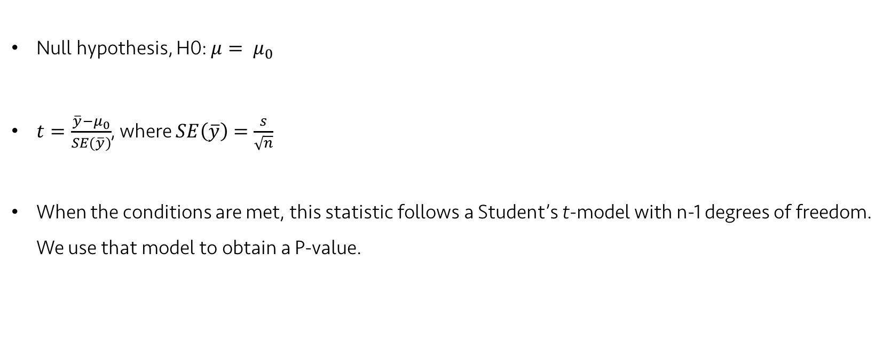
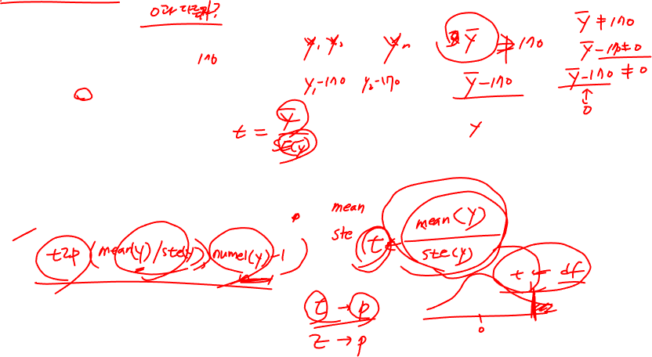
Lecture 17
One sample t-test for the mean
Null hypothesis, H0: $μ= μ_{0}$
$t=\frac{\overline{y}−μ_{0}}{SE(\overline{y})}$, where $SE\left(\overline{y}\right)=\frac{s}{\sqrt{n}}$
When the conditions are met, this statistic follows a Student’s t-model with n-1 degrees of freedom. We use that model to obtain a P-value.
$t=\frac{\overline{y}−μ}{SE(\overline{y})}$
CHOONG-WAN WOO | COCOAN lab | http://cocoanlab.github.io

Slide 13
Lecture 17
Quiz 17-02
https://forms.gle/xBk8LWa5E4x8YDuQ6
$t=\frac{\overline{y}−μ}{SE(\overline{y})}$
CHOONG-WAN WOO | COCOAN lab | http://cocoanlab.github.io

Slide 14
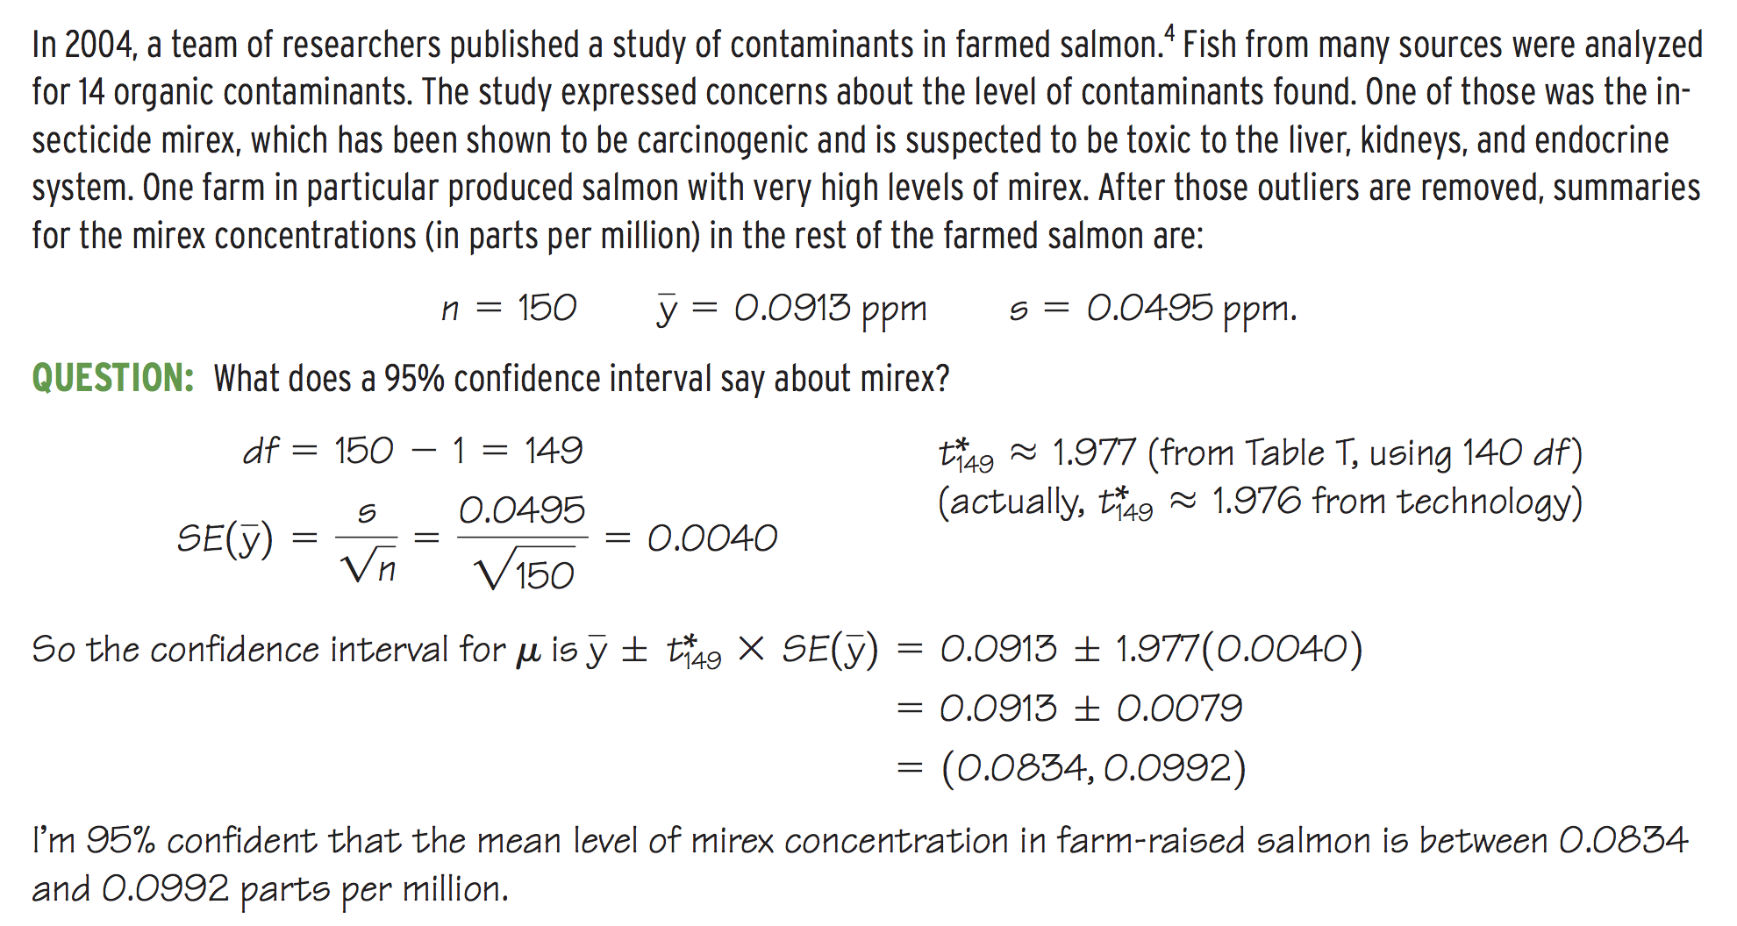
Lecture 17
Examples: Confidence interval
$t=\frac{\overline{y}−μ}{SE(\overline{y})}$
CHOONG-WAN WOO | COCOAN lab | http://cocoanlab.github.io

Slide 15
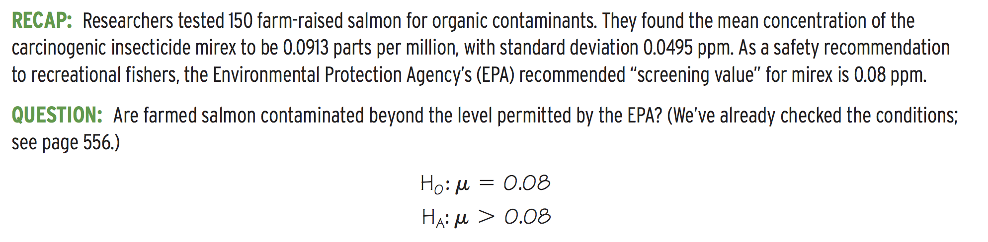
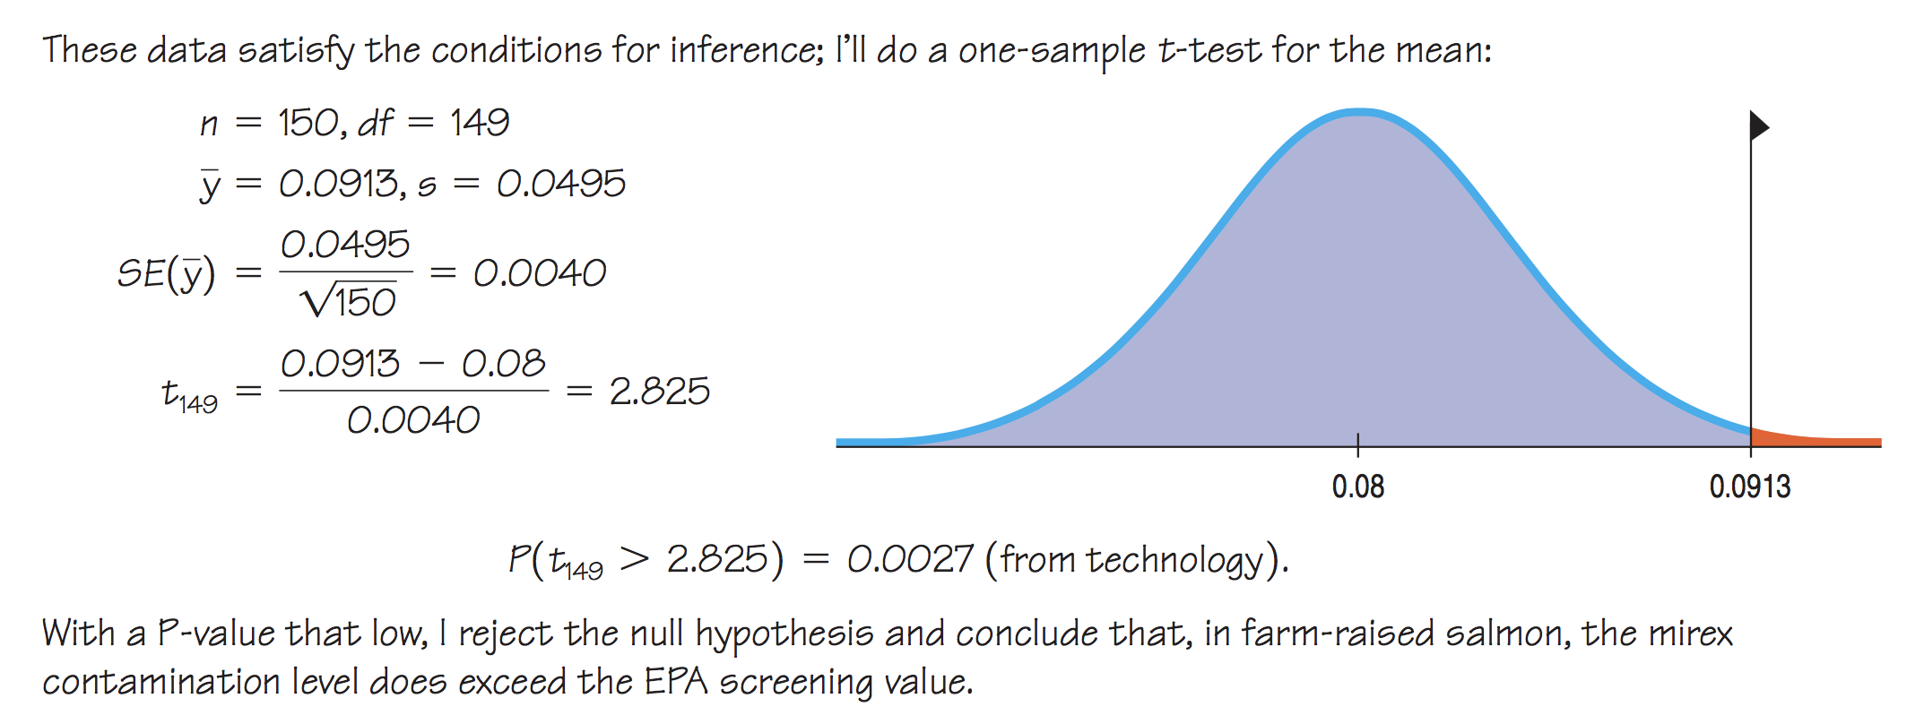
Lecture 17
Examples: One-sample t-test
$t=\frac{\overline{y}−μ}{SE(\overline{y})}$
CHOONG-WAN WOO | COCOAN lab | http://cocoanlab.github.io

Slide 16
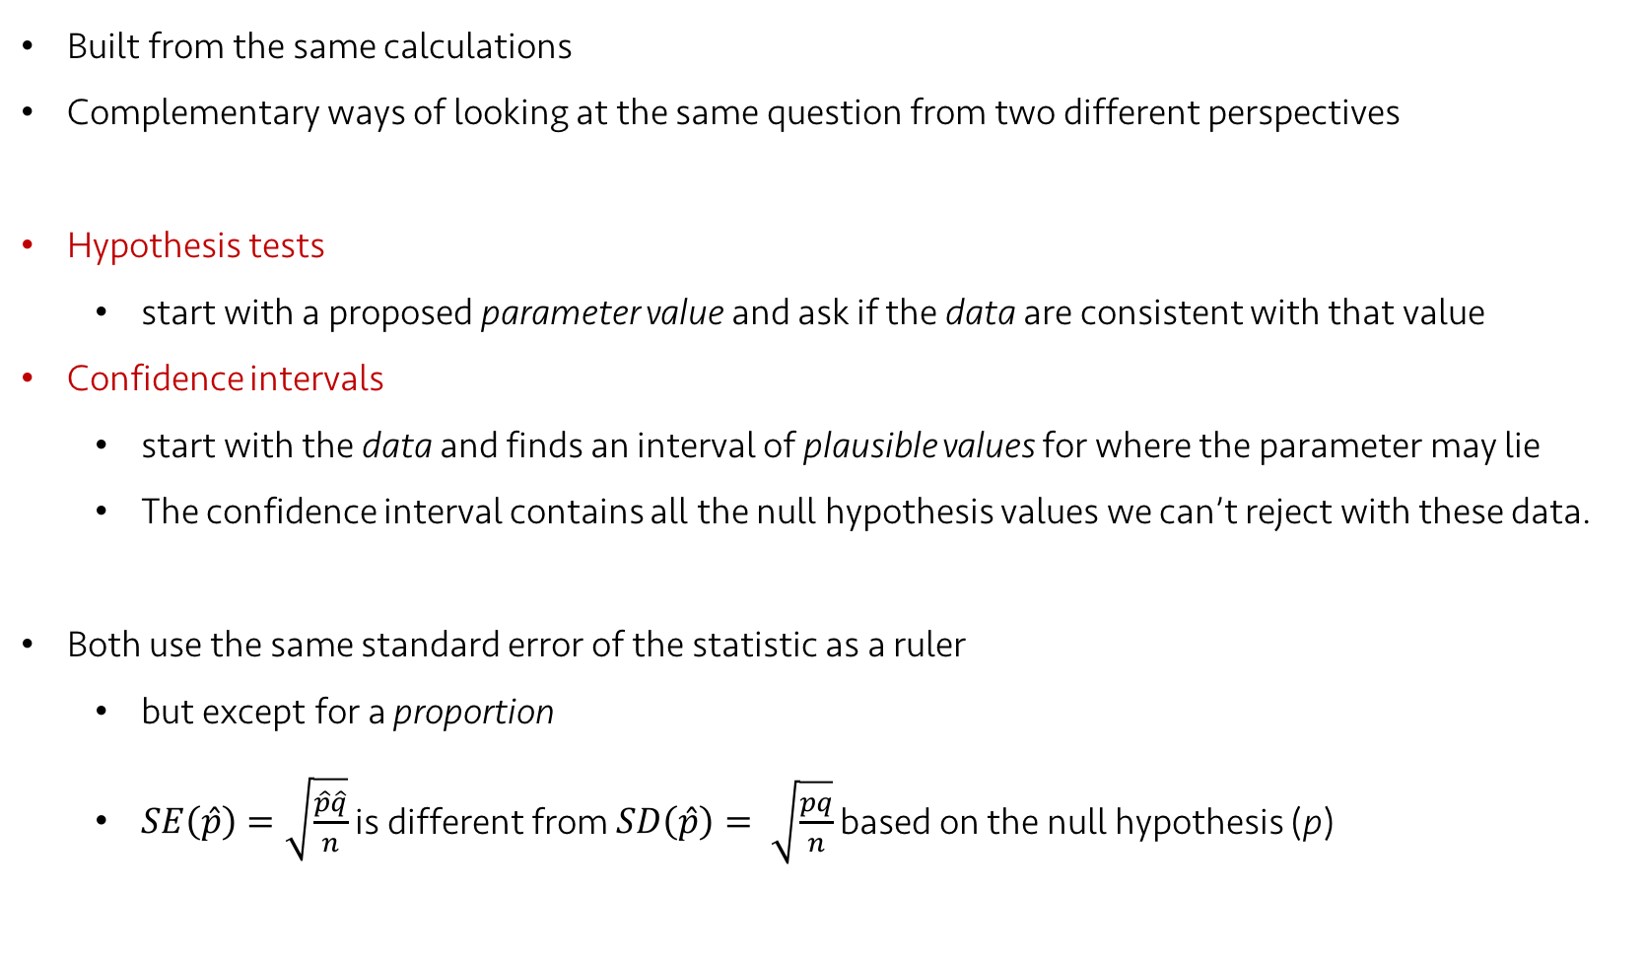
Lecture 17
Confidence Intervals and Significance tests
Built from the same calculations
Complementary ways of looking at the same question from two different perspectives
Hypothesis tests
start with a proposed parameter value and ask if the data are consistent with that value
Confidence intervals
start with the data and finds an interval of plausible values for where the parameter may lie
The confidence interval contains all the null hypothesis values we can’t reject with these data.
Both use the same standard error of the statistic as a ruler
but except for a proportion
$SE\left(\hat{p}\right)=\sqrt{\frac{\hat{p}\hat{q}}{n}}$ is different from $SD\left(\hat{p}\right)= \sqrt{\frac{pq}{n}}$ based on the null hypothesis (p)
CHOONG-WAN WOO | COCOAN lab | http://cocoanlab.github.io

Slide 17
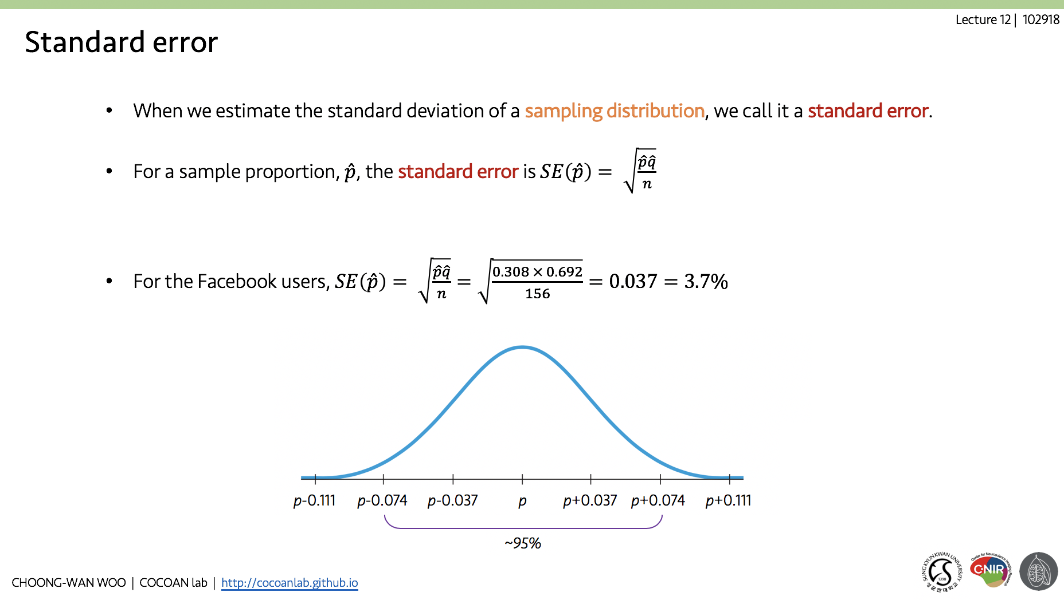
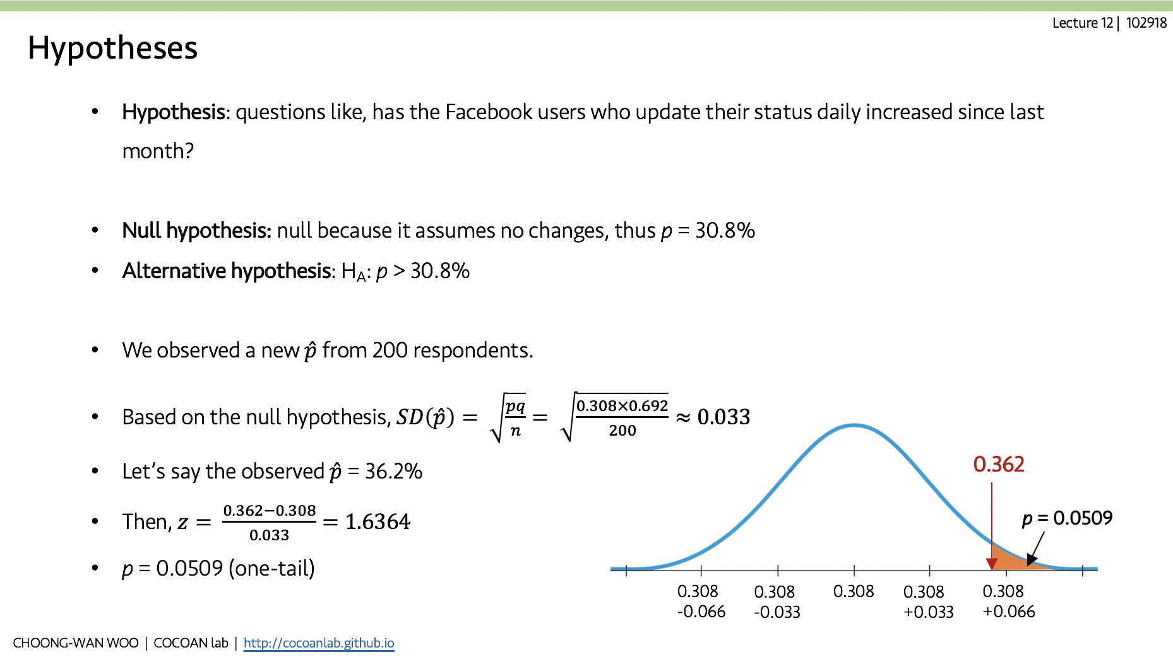
$SE\left(\hat{p}\right)=\sqrt{\frac{\hat{p}\hat{q}}{n}}$ is different from $SD\left(\hat{p}\right)= \sqrt{\frac{pq}{n}}$ based on the null hypothesis (p)
Lecture 17
CHOONG-WAN WOO | COCOAN lab | http://cocoanlab.github.io

Slide 18
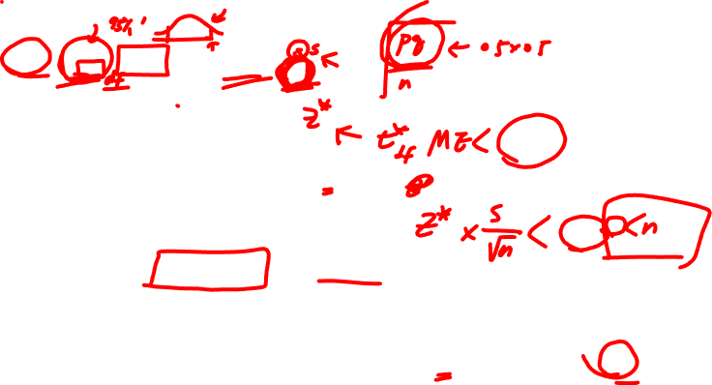
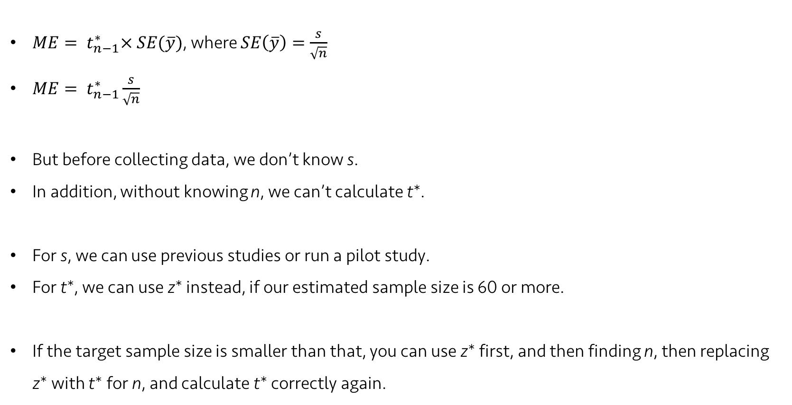
Lecture 17
Choosing the Sample size
$ME= t_{n−1}^{∗}× SE(\overline{y})$, where $SE\left(\overline{y}\right)=\frac{s}{\sqrt{n}}$
$ME= t_{n−1}^{∗}\frac{s}{\sqrt{n}}$
But before collecting data, we don’t know s.
In addition, without knowing n, we can’t calculate t*.
For s, we can use previous studies or run a pilot study.
For t*, we can use z* instead, if our estimated sample size is 60 or more.
If the target sample size is smaller than that, you can use z* first, and then finding n, then replacing z* with t* for n, and calculate t* correctly again.
CHOONG-WAN WOO | COCOAN lab | http://cocoanlab.github.io

Slide 19
Lecture 17
Quiz 17-03
https://forms.gle/WHUhuhoHyaBrnEjKA
CHOONG-WAN WOO | COCOAN lab | http://cocoanlab.github.io

Slide 20
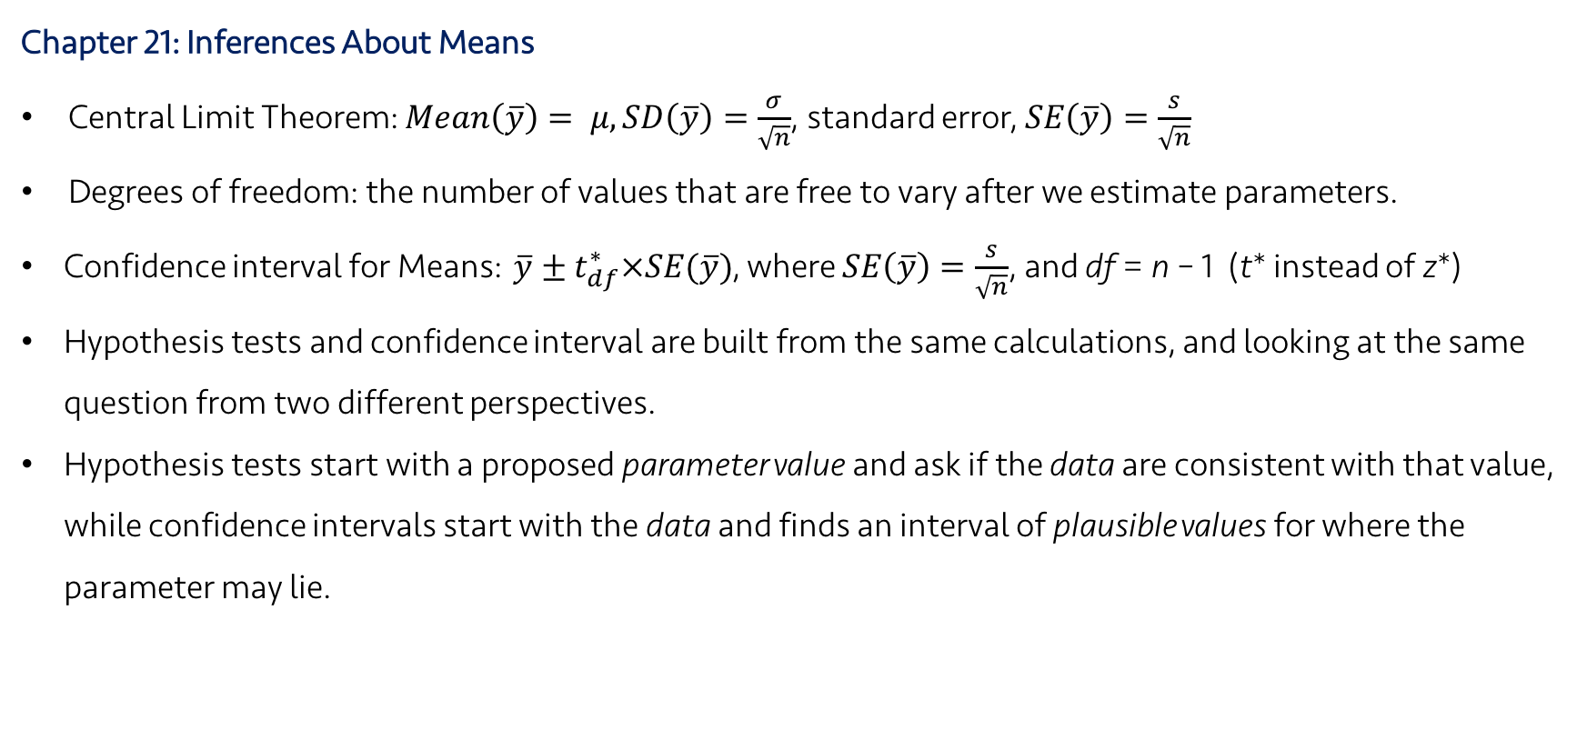
Lecture 17
Key Points
Chapter 21: Inferences About Means
Central Limit Theorem: $Mean\left(\overline{y}\right)= μ, SD\left(\overline{y}\right)=\frac{σ}{\sqrt{n}}$, standard error, $SE\left(\overline{y}\right)=\frac{s}{\sqrt{n}}$
Degrees of freedom: the number of values that are free to vary after we estimate parameters.
Confidence interval for Means: $\overline{y}±t_{df}^{∗}×SE(\overline{y})$, where $SE\left(\overline{y}\right)=\frac{s}{\sqrt{n}}$, and df = n – 1 (t* instead of z*)
Hypothesis tests and confidence interval are built from the same calculations, and looking at the same question from two different perspectives.
Hypothesis tests start with a proposed parameter value and ask if the data are consistent with that value, while confidence intervals start with the data and finds an interval of plausible values for where the parameter may lie.
CHOONG-WAN WOO | COCOAN lab | http://cocoanlab.github.io

